Slide 1
General Guidelines for Presentation
Slides should not be too heavy with content. Better to create point wise.
If you require more than one slide for any point, right click on that point slide then select duplicate slide and modify the duplicated slide.
Diagrams must be aligned at centre and clearly visible with caption.
All the mentioned fonts, font size, title content, etc should not change and strictly as per the given format and guidelines.
Notes:
1

Slide 2

“ GrowGreen e-Nursery ”
PRANJAL KAPSE – 21104084
JANHVI KOSKE – 21104015
VEDANTI NANDVIKAR- 21104024
Project Guide
SHITAL AGRAWAL
Notes:
2

Slide 3
Contents
Introduction
Objectives
Scope
Features / Functionality
Project Outcomes
Technology Stack
Block Diagram/ Flow
Notes:
3

Slide 4
1. Introduction
GrowGreen is an online platform which provides information about plants and helps user to purchase plants at tip of their fingers.
Problem Identified :
Researching and visiting multiple nurseries to find the right plant can get quite daunting and time consuming.
Solution Proposed :
The GrowGreen application is an online nursery that allows user to shop plants from the comfort and convenience of your homes.
Using this application, customers can view all the available plants with details such as the plant's cost, level of maintenance required, watering schedule, etc.
Notes:
4

Slide 5
2. Objectives
1. To achieve efficiency.
2. To create user friendly interface in python.
To reduce time and efforts of users
To help user buy plants in one click.
To provide information and details about plants in one place.
To provide detailed instructions about maintainance of plants.
Notes:
5

Slide 6
3. Scope
1. Can be applied in android platform .
2. Can be used by any user to purchase the online plants.
3. Can be useful to get appropriate information by viewing short summery about the plants items.
4. Can be more enjoyable and easier than real- world shopping.
Notes:
6

Slide 7
4. Feature /Functionality
There are two users Admin and Customer.
Admin
The admin can view, add, delete, and update plants details.
Admin has the privilege of viewing customers, plants details, order details and customer reviews.
Customer
Customer can view the plants and their details and add it to their cart or keep it in their wish list.
Customer can view their cart and make payments.
Notes:
7

Slide 8
5. Outcome of Project
Admin module:-
1. Admin first register and log in himself in the application.
2. He can view the order which can be added to cart from the customer side.
3. He can generate invoice to the customer and also if any plant wants to add
4. The application then he can update the information.
Notes:
8

Slide 9
Customer module:-
1. Customer registers and log in himself in the application.
2. He can select the plant item and purchase the plant by comparing prices with different shop keeper.
3. Purchased plant details will be added to the cart.
4. He can pay amount through credit card, debit card, phone pay.
5. Customer can Logout from the application.

Slide 10
6. Technology Stack
Write what you have planned to develop front end ( GUI ) & Backend (Database if applicable)
Python
Pycharm
Tkinter software
SQLite database
Notes:
10

Slide 11
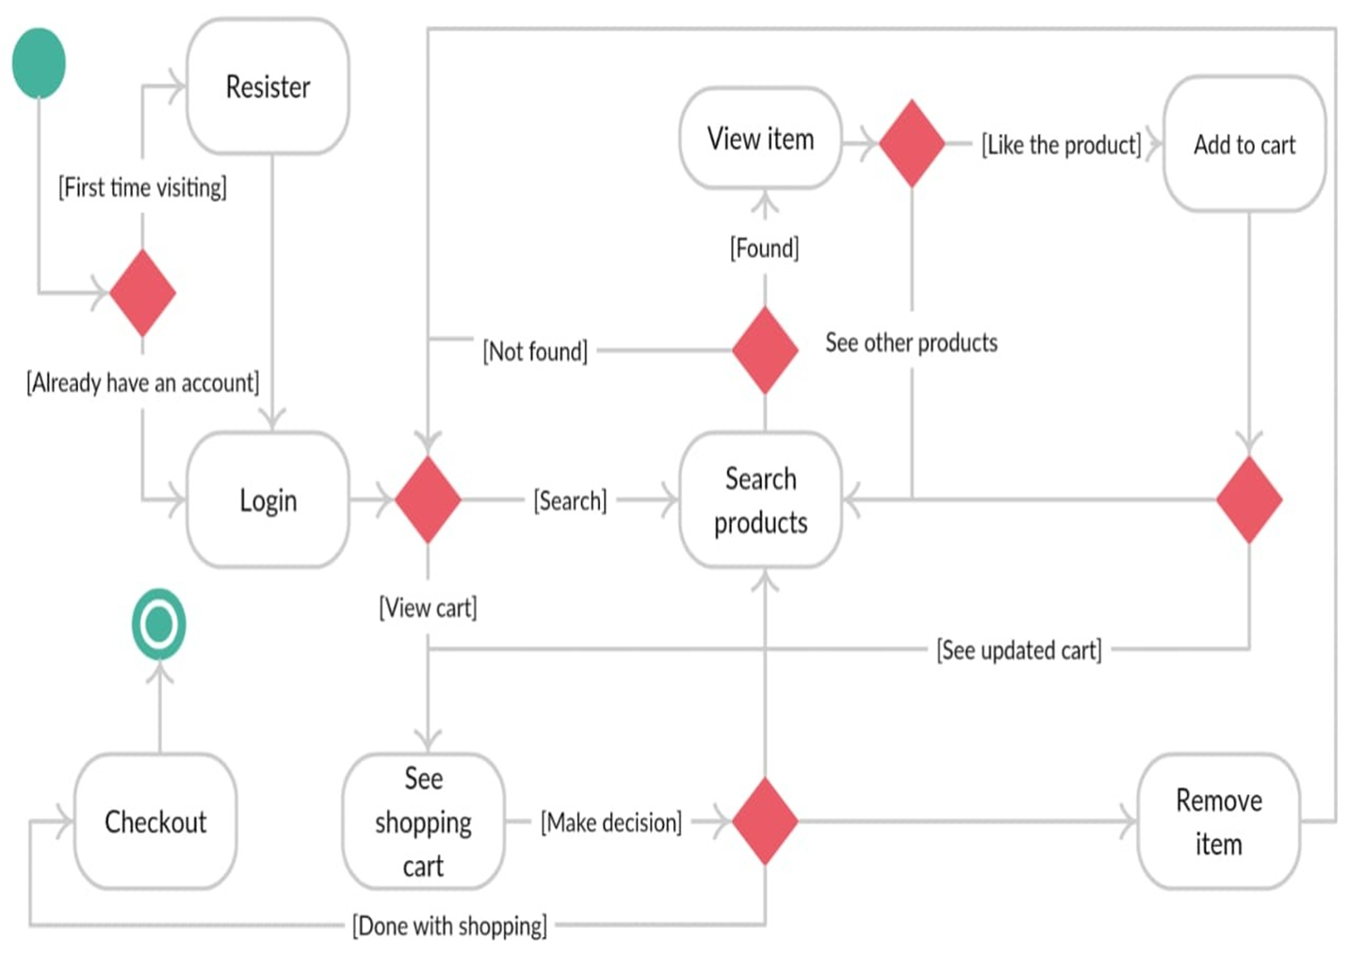
7. Block Diagram/ Flow Chart
Notes:
11

Slide 12
Thank You...!!
Notes:
12

